Slide 1
Reverse Dictionary
Adithya Bhaskar, Jash Ashish Shah, Ankit Kumar Jain

Slide 2
Problem Statement
Given a phrase, output the word described by it.
Example: A formal speech praising someone or something highly → encomium.
Other words also possible - paean, eulogy, …
Hence output top k words (k = 5-100)
Reference and Baseline for comparison: “Reverse Dictionary” by Kuo et. al. at Stanford [1]
[1] https://web.stanford.edu/class/cs224n/reports/custom_116806273.pdf

Slide 3
Dataset
Use a dictionary to get (word, definition) pairs
Originally used Webster’s and EDMT Dictionary
Low quality – semicolons used both in-meaning and to delineate meaning boundaries in string
60.8% and 49.8% of examples either had meanings with < or = 3 words, or had the word share a prefix of length > min(length,6) with one in the meaning, respectively.
Validation loss did not improve when using these – hence resorted to new dataset

Slide 4
Dataset
Finally used:
WordNet-extracted (word, meaning) pairs - 61027 words
Self-created dataset - using words list from /usr/dict/words, wrote a web crawler that extracted meanings by parsing vocabulary.com HTML responses - 89930 high quality (word, meaning) pairs
Model learnt much better with this
Train-Validation-Test split: 138880-7246-4831

Slide 5
Model
Find
Top k
Closest
Word
Vectors
Input word sequence
100d
Word
Vector
BERT
BiLSTM
FC Layer

Slide 6
Model
Use a pretrained BERT model to encode input
Then pass through a BiLSTM layer
Found empirically to work the best -
Directly passing to FC layer often got stuck predicting non-existent words like email ids (which somehow exist in Glove; tested upto 20 epochs)
Using 4 x BiLSTM with dropout gave nearly same performance but took longer to converge (tested upto 10 epochs)
Then pass through an FC layer to predict word vector
The k closest Glove word vectors are predicted (see next slide)

Slide 7
Loss Function
Synonyms must be partially rewarded
Loss proportional to MSE distance between predicted word vector and ground truth word vector
Synonyms expected to have close-by word vectors
Jog
Run
Swim

Slide 8
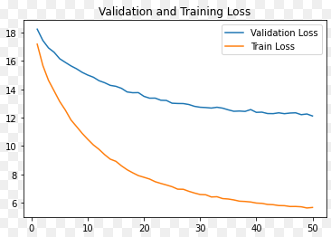
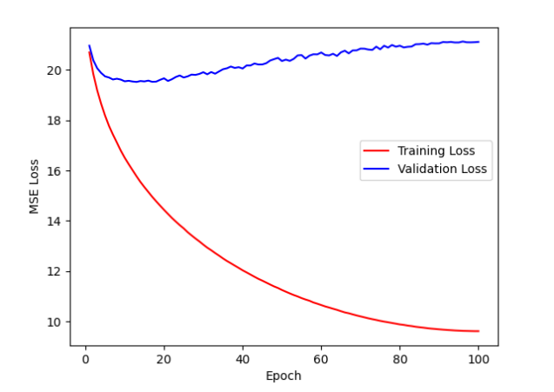
Training
50 epochs using Adam, with learning rate initially 2e-5, at ~45min per epoch
Learning Rate linearly dropped to 0 over 50 epochs.
Comparison of loss v/s time with reference published graph shown below - ours does better in terms of val loss.
Ours
From Reference [1]

Slide 9
Results
Results given as top-1, top-10 and top-100 accuracy (test set).
Top-k accuracy = % of time when correct word was ranked in top k
Glove has ~35k total words
Comparison v/s published result in reference [1]
 | Top-1 Accuracy (test) | Top-10 Accuracy (test) | Top-100 Accuracy (test) | MSE Loss (val)
Ours | 48.706% | 58.953% | 65.618% | 12.118
Baseline published in reference | 7.9% | 20.0% | 37.0% | 20.15

Slide 10
Observations
Quality of data is very important - progress was much smoother with custom + WordNet data vis-a-vis Webster+EDMT
Validation Loss was still decreasing around epoch 50
More performance may be squeezed out if model trained for longer
BART gave good loss decreases (checked for epochs 1-3) but was slower to train, hence we decided to pursue the BERT model.

Slide 11
Thank You

